Slide 1
Internship studio ethical hacking-task 2
Test for vulnerabilities in site https://zero.webappsecurity.com/

Slide 2
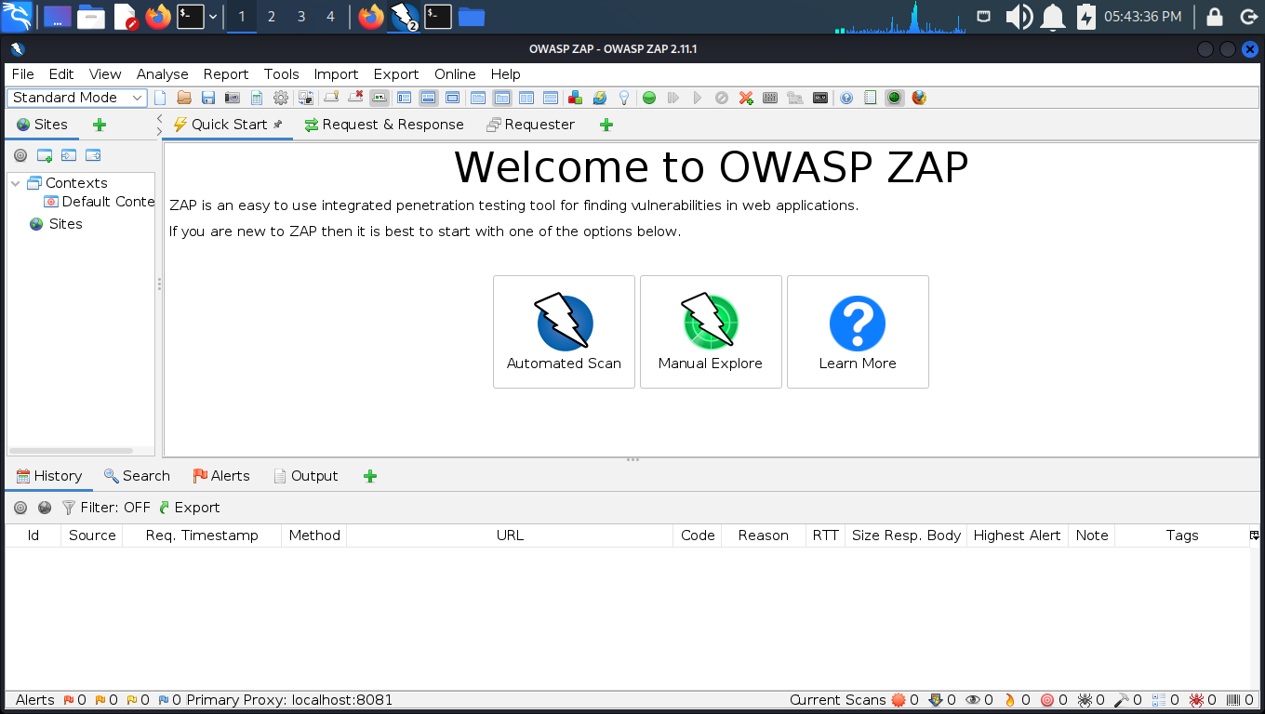
Using owasp for scanning

Slide 3
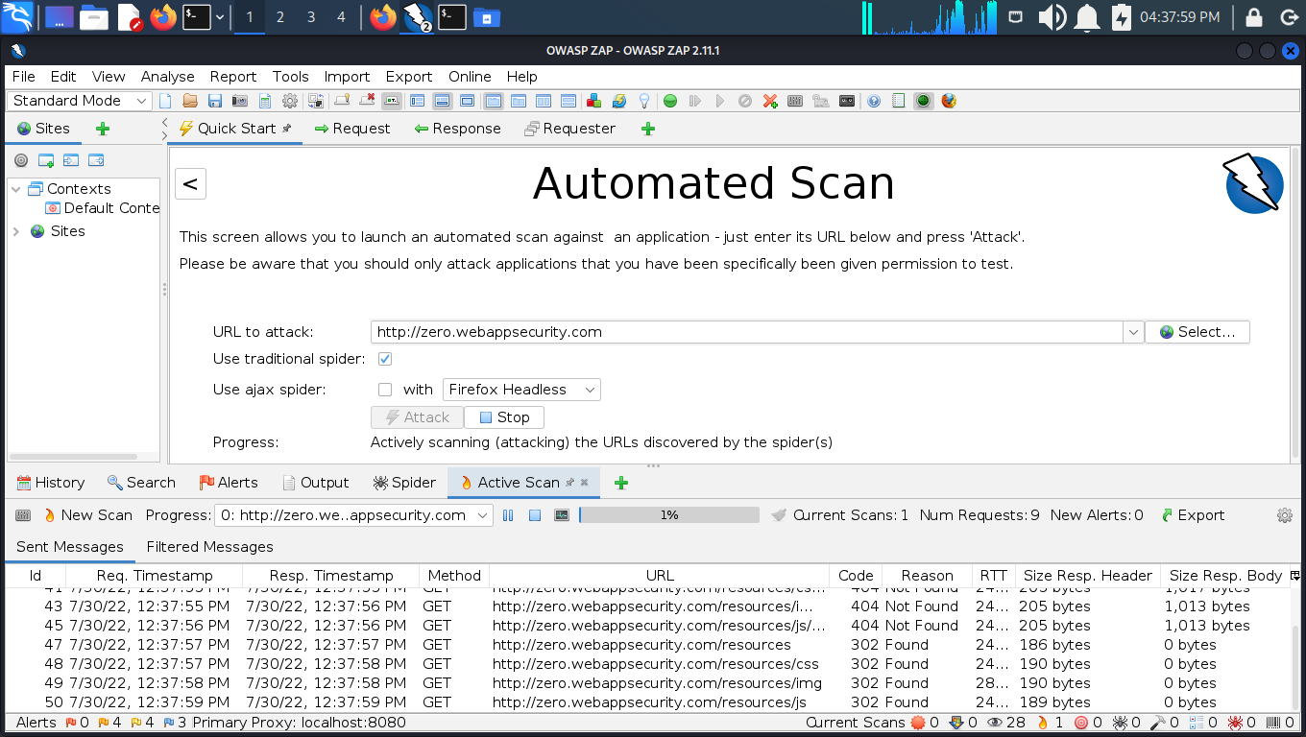
Attack on the site

Slide 4
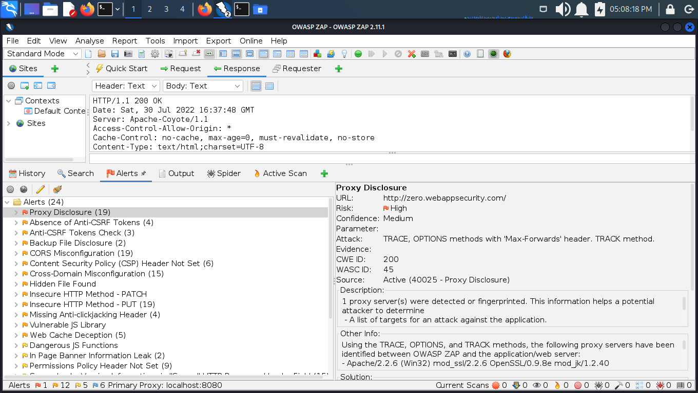
All vulnerabilities scanned by owasp

Slide 5
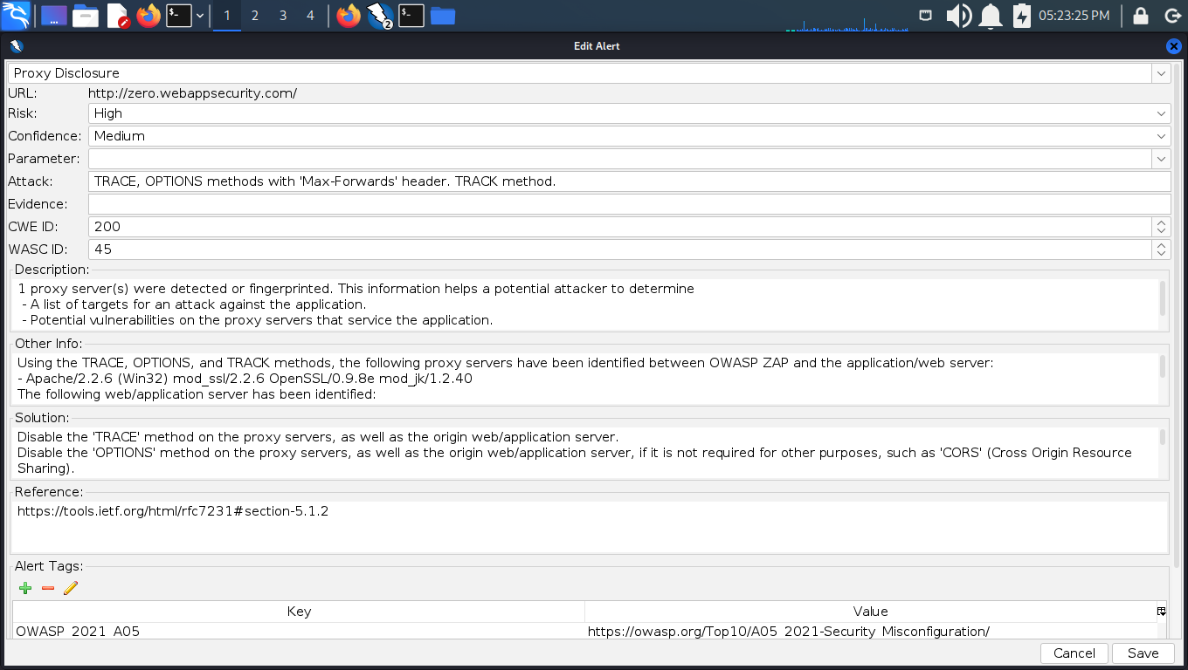
vulnerability report made by owasp for a critical vulnerability

Slide 6
Report
Proxy Disclosures
Risk: | High
Confidence: | Medium
Attack: | TRACE, OPTIONS methods with 'max-forwards' header. TRACK method.
CWE id: | 200
WASC id: | 45
Source: | Active (40025 - proxy disclosure)

Slide 7
Description: | 1 proxy server(s) were detected or fingerprinted. A proxy is a simple server which forwards requests on your behalf. For example, if you’re using a proxy to access google.com, your request will first be sent to the proxy server, which will then in turn make the actual request to google.com, and return the result back to you. This information helps a potential attacker to determine : - A list of targets for an attack against the application. - Potential vulnerabilities on the proxy servers that service the application. - The presence or absence of any proxy-based components that might cause attacks against the application to be detected, prevented, or mitigated.
Information: | Using the TRACE, OPTIONS, and TRACK methods, the following proxy servers have been identified between OWASP ZAP and the application/web server: - Apache/2.2.6 (Win32) mod_ssl/2.2.6 OpenSSL/0.9.8e mod_jk/1.2.40 The following web/application server has been identified: - Apache-Coyote/1.1 The 'TRACE' method is enabled on one or more of the proxy servers, or on the origin server. This method leaks all information submitted from the web browser and proxies back to the user agent. This may facilitate 'Cross Site Tracing' attacks. A Cross-Site Tracing (XST) attack involves the use of Cross-site Scripting (XSS) and the TRACE or TRACK HTTP methods. According to RFC 2616, “TRACE allows the client to see what is being received at the other end of the request chain and use that data for testing or diagnostic information.”, the TRACK method works in the same way but is specific to Microsoft’s IIS web server. XST could be used as a method to steal user’s cookies via Cross-site Scripting (XSS) even if the cookie has the “Http Only” flag set or exposes the user’s Authorization header. The TRACE method, while apparently harmless, can be successfully leveraged in some scenarios to steal legitimate users’ credentials. This attack technique was discovered by Jeremiah Grossman in 2003, in an attempt to bypass the Http Only tag that Microsoft introduced in Internet Explorer 6 sp1 to protect cookies from being accessed by JavaScript. As a matter of fact, one of the most recurring attack patterns in Cross Site Scripting is to access the document.cookie object and send it to a web server controlled by the attacker so that they can hijack the victim’s session. Tagging a cookie as Http Only forbids JavaScript to access it, protecting it from being sent to a third party. However, the TRACE method can be used to bypass this protection and access the cookie even in this scenario.

Slide 8
Solution: | Disable the 'TRACE' method on the proxy servers, as well as the origin web/application server. Disable the 'options' method on the proxy servers, as well as the origin web/application server, if it is not required for other purposes, such as 'cors' (cross origin resource sharing). Configure the web and application servers with custom error pages, to prevent 'fingerprintable' product-specific error pages being leaked to the user in the event of http errors, such as 'track' requests for non-existent pages. Configure all proxies, application servers, and web servers to prevent disclosure of the technology and version information in the 'server' and 'x-powered-by' http response headers.
References | Https://tools.Ietf.Org/html/rfc7231#section-5.1.2
Tags | Owasp_2021_a05: Https://owasp.Org/top10/a05_2021-security_misconfiguration/ OWASP_2017_A06: Https://owasp.Org/www-project-top-ten/2017/a6_2017-security_misconfiguration.Html

